Slide 1


zWrap Automating Bare-Metal Deployment of MATLAB Functions on Embedded Targets
Di Domenico Gianfranco
PhD Student @Politecnico di Milano
26/07/2023

Slide 2

INTRODUCTION

Slide 3
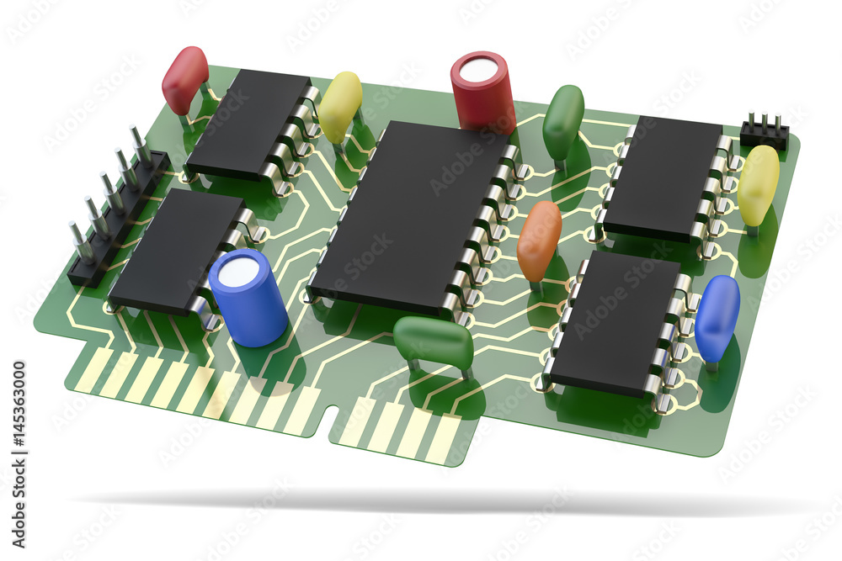

MATLAB Coder
The MATLAB Coder is a powerful tool. However:
It has limited Hardware Support Packages for direct deployment
No support for interface outside HSPs – one has to write its own interfaces
Random OS limitations (why no Deep Learning Toolbox on MacOS?)
Unfriendly if one is not familiar with embedded coding
Something just does not work – i.e. tic/toc functions on embedded targets
💔
One thing, however, works almost flawlessly: the code generation function.

Slide 4
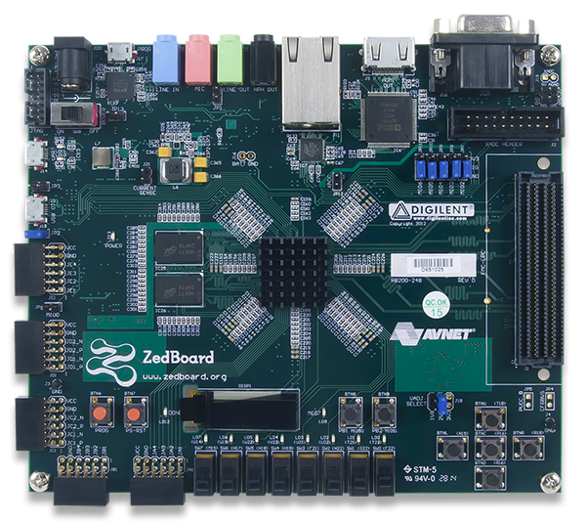
ZedBoard
I worked with the Digilent ZedBoard. The board fetaures:
Zynq-7000 System-on-a-chip with:
Dual-Core ARM Cortex-A9 Processing System (PS) @667 MHz
Programmable Logic (PL) – this means an FPGA
Lots of on-chip interfaces
512 MB of DDR3 memory
Also read: 512 MB of RAM
Comparable to an on-board computer for a CubeSat (high-end of spacecraft computers)
Lots of hardware interfaces to play with – UART, Ethernet, etc.
Different boot modes possible
Usually a nightmare to connect to the computer because of drivers, cables, etc.

Slide 5

zWrap
zWrap is a tool that allows quick deployment of code-ready MATLAB functions on bare-metal targets.
Fully automated
One to two commands have to be executed by the user
Minimal overhead
The interface running on the board is designed to be as lightweight as possible, minimizing communication overhead.
Drop-in
zDrop outputs drop-in interfaces for MATLAB and Simulink to be easily integrated in existing models
Extends MATLAB Coder
(drop-in logo)
zWrap relies on C/C++ source codes, extending the capabilities of existing MATLAB support packages.

Slide 6
zWRAP CONCEPTS

Slide 7

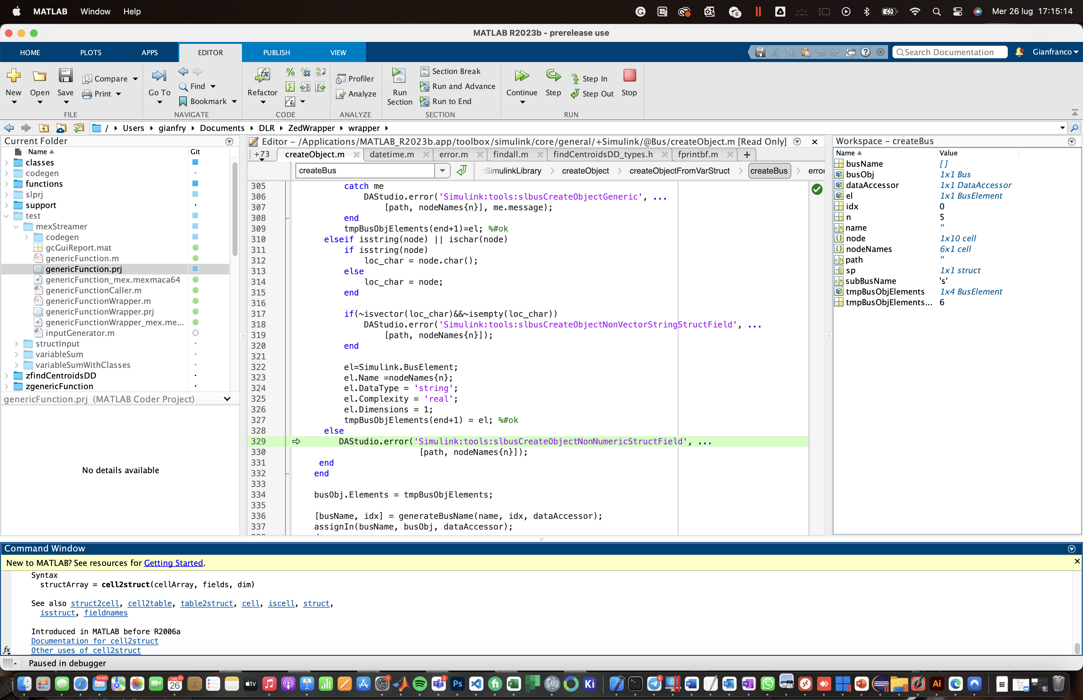






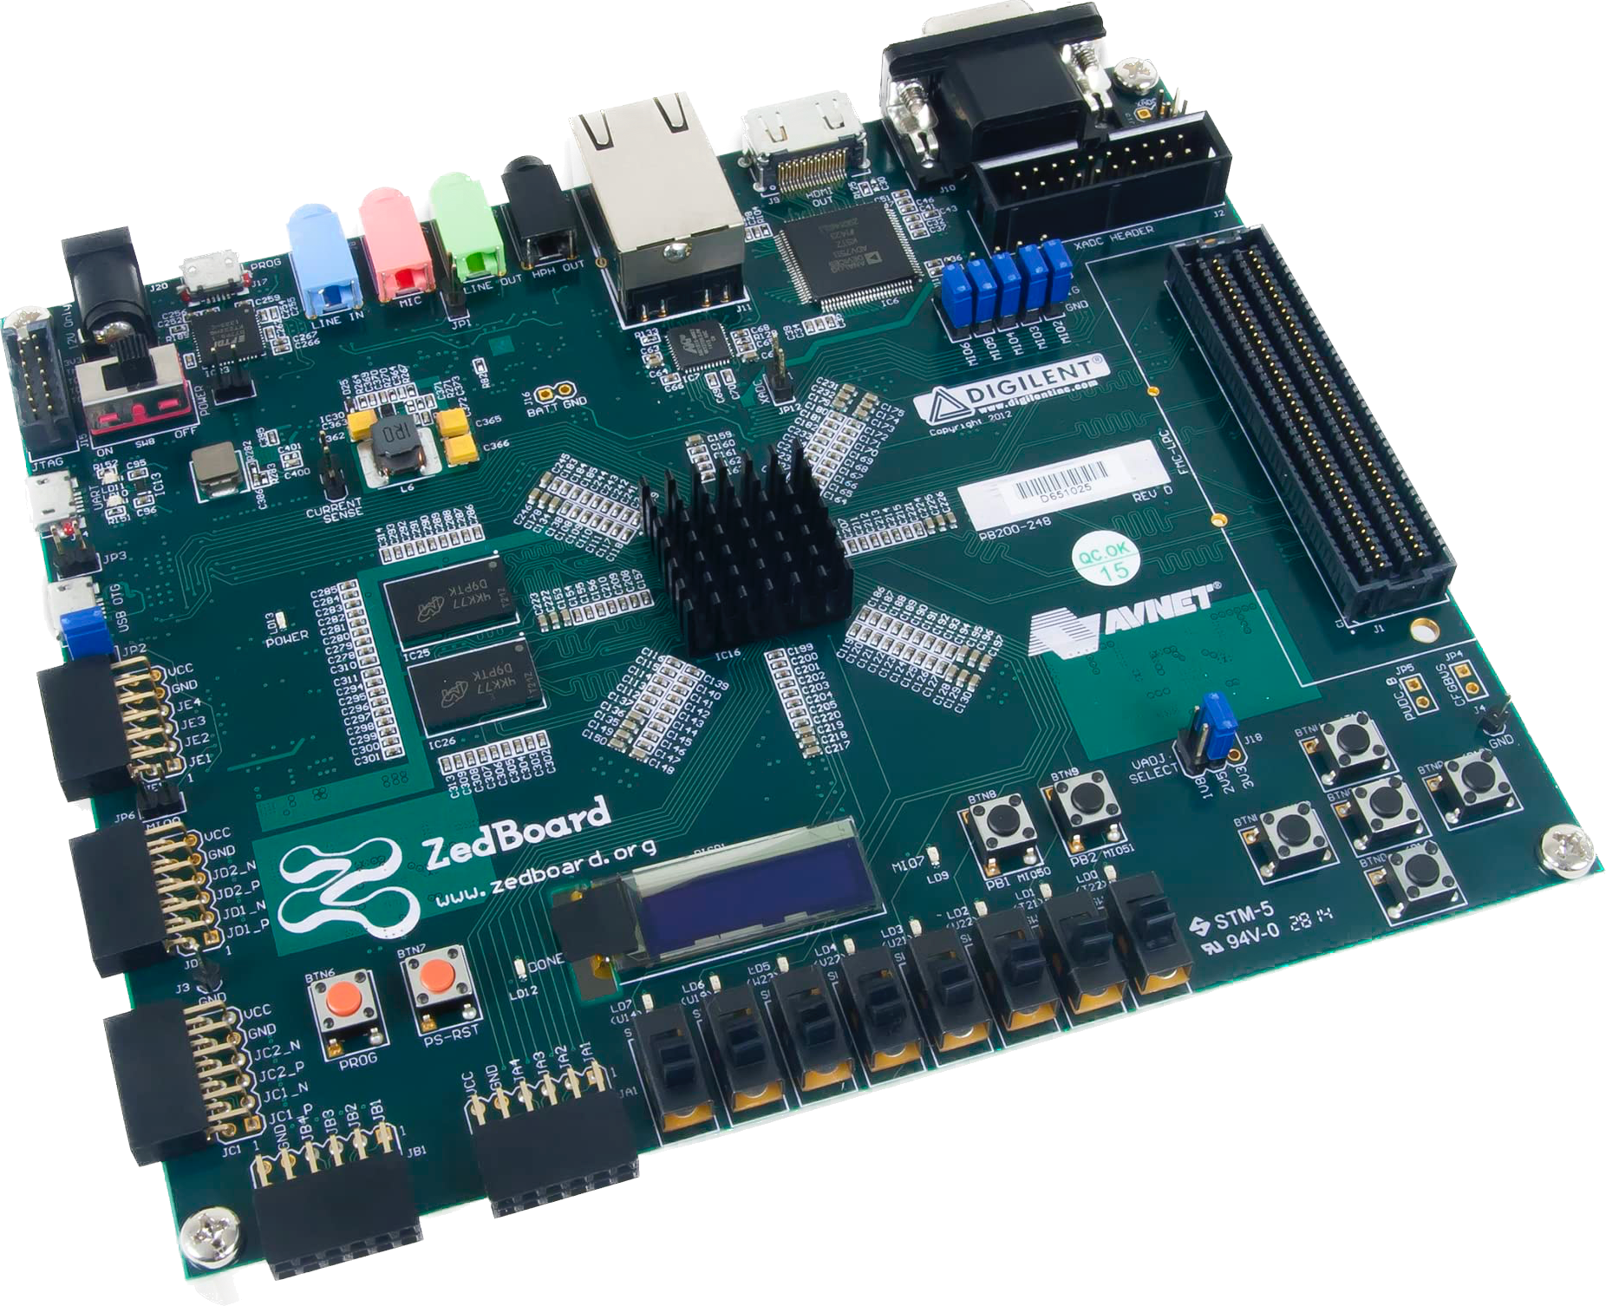


Workflow
C/C++ code generation
zWrap
C code generation
C code generation
Host
Input parsing (type, size, …)
Input raw memory mapping
C++ call template generation
Memory mapping generation
IP stack configuration (Core0)
Linker script generation
Makefile tuning and execution
MATLAB interface generation
Simulink block library generation
C code generation
Generated C/C++ sources and headers
Drop-in MATLAB function
Drop-in Simulink Block Library
zWrap
Codegen support files (buildInfo, codeInfo)
Board
C code generation
Vendor-specific
C code generation
SHARED MEMORY
(OCM, DDR)
0
1
BOOT.bin SD Card Image
Host Communication
lwIP Ethernet Stack
MATLAB Function
Board Support Package (BSP)

Slide 8

Under the hood – input parsing (1)
For a generic C/C++ application, the MATLAB coder converts the following MATLAB types:
Primitives (int, float, double, …)
Matrices (variable size, fixed size)
Structures
Cell Arrays (heterogeneous, homogeneous)
Strings
MATLAB Classes
To their corresponding C/C++ types. The kind of implementation is documented in the codeInfo.mat object returned from the coder.
Examples of implementations are reported on the right.
struct
struct
_data array
Matrix (variable)
_size array
Homogeneous Cell
array
Heterogeneous Cell
struct

Slide 9
Under the hood – input parsing (2)
What we want is something like this:
Host calls a MATLAB function/executes the Simulink block without adapting the call template of the original MATLAB function.
Data are passed to the board.
The board collects the data. We want minimal overhead in terms of memory/processing time. Then, it executes the function in a real-time environment.
The board returns the output(s)
The host collects the output. We want the outputs to be exactly the same of the original MATLAB function in order to minimize interfacing overhead with existing code/models.

Slide 10
Under the hood – input parsing (3)
In order to achieve this, we must be able to:
Identify a suitable data structure to minimize the parsing overhead on the board
Develop converting functions to map back and forth from the identified data structure to MATLAB types

Slide 11
Under the hood – input parsing (3)
In order to achieve this, we must be able to:
Identify a suitable data structure to minimize the parsing overhead on the board
Develop converting functions to map back and forth from the identified data structure to MATLAB types
DATA STRUCTURE
CONVERTING FUNCTIONS
There is no data structure. We use raw memory serialization.
We exploit the information in the codeInfo object to convert between MATLAB types and C/C++ memory mapping

Slide 12

Raw memory serialization
Passing the inputs as raw memory representation allows to:
Minimize the on-board input parsing burden: the only operation required is a memcpy to a dedicated I/O memory region, shared between the two cores
Minimize the on-board memory for the communication application: we don‘t need to allocate new variables to process the outputs (as it would be, for instance, for SLIP framing, YAML, JSON, or protobuf serialization).
HOST
BOARD
Memory-serialized inputs
(TCP stream)
Dedicated I/O shared memory
0
1
Memory-serialized outputs
(TCP stream)
Ethernet

Slide 13
Converting functions
The conversion to raw memory representation is handled by the host. The functions are automatically generated by considering:
The information in the codeInfo.mat file on input type, size, and implementation
The deterministic memory padding policy of the target compiler (i.e., ARM gcc)
The result consist of two MATLAB functions, specific for the application:
inputSerializer has the same function input signature of the original function, but returns a byteArray corresponding to the memory representation.
outputParser has the same function output signature of the original function, but accepts as input the byteArray corresponding to the on-board memory representation
INPUTS
Original function
zWrapped function
inputSerializer
function
Deployed function
outputParser
OUTPUTS

Slide 14
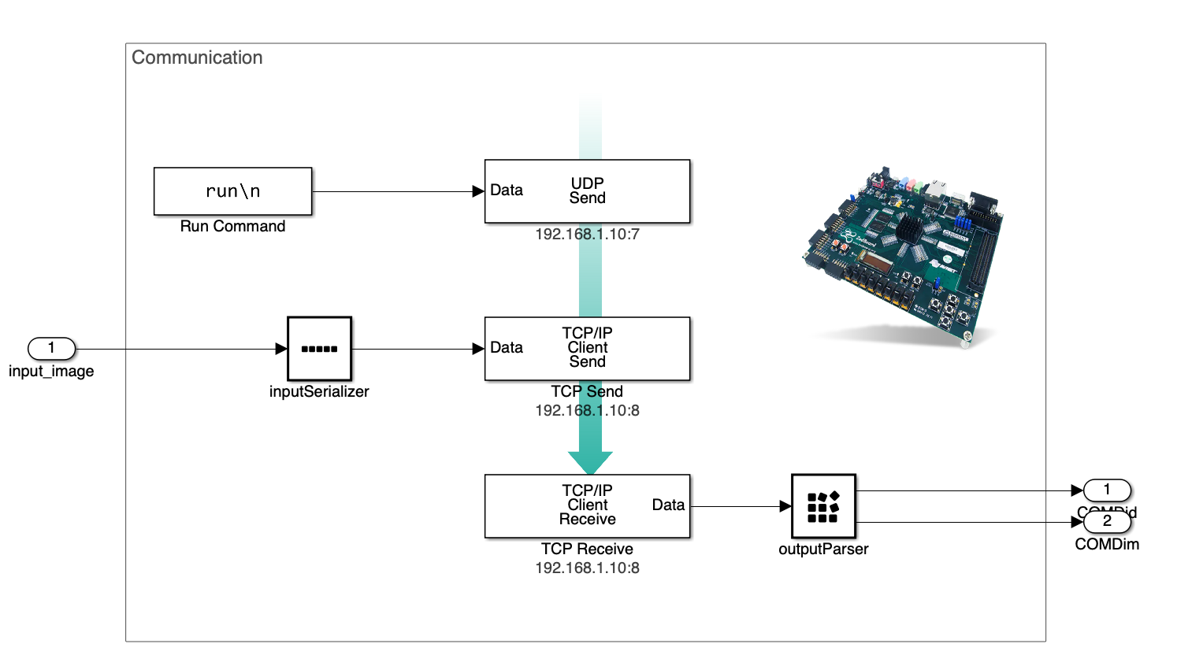
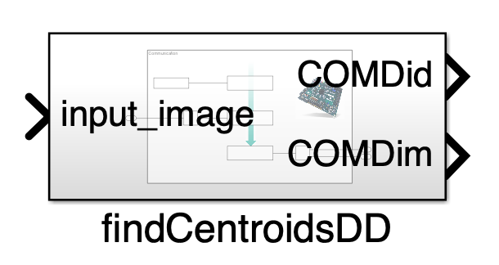
HOST – Simulink interface
Once the MATLAB function is generated, even a Simulink block implementing the communication with the board is generated.

Slide 15
The coderArgument class
The generation of the different functions for memory parsing happens with an object-oriented approach.
For each input in the codeInfo structure, we generate a coderArgument object. coderArgument is a parent class with a set of derived classes (see class diagram).
Each class is characterized by these fundamental fuctions:
generateSerializerFunction() % Returns the raw memory serializing code lines
generateParserFunction() % Returns the raw memory parsing code lines
getCppCallTemplate() % Returns the C/C++ symbol for the implementation
getTemplate() % Returns an example of the corresponding MATLAB type (i.e. for testing)

Slide 16
The coderArgument class (2)

Slide 17
Memory Structure
The memory management is handled by zWrap. In particular, the resulting memory map like:
A minimal section for the interface application on Core0
I/O shared data – dimensioned according to the MATLAB inputs/outputs
All the extra memory is dedicated to Core1
These settings are reflected in the ldscript.ld script used during linking.
Additionally, the zWrap function manages the AMP (Asynchronous Multi Processing) parameters and flags for the board application, by defining the start address of the Core1 application (to be set by the Core0 application).

Slide 18
C/C++ wrapper
The class methods are also used to generate the C/C++ code needed to execute the function on the board. In particular, an inputStruct type and an outputStruct type are defined as C structures containing all the inputs/outputs.
The raw memory address of the input/output wrapper structures are interpreted as pointer to inputStruct (pI) and outputStruct (pO) objects.
The resulting function call is automatically generated, and is as simple as:
1 // Pointers to shared memory
2 inputStruct* pI = (inputStruct*) INPUT_STRUCT_ADDR;
3 inputStruct* pO = (outputStruct*) OUTPUT_STRUCT_ADDR;
4
5 myFunction (pI->input1, pI->input2, &(pO->output1))

Slide 19


BOOT.bin image generation
The SD card is both the fastest and the most convenient way to deploy the application on the ZedBoard. In order to generate the BOOT.bin image, the following actions are automatically performed by the makefiles in the BSP:
Compilation and linking for the Core0 application
Compilation and linking for the Core1 application
Generation of the BOOT.bin SD card image with the bootgen command
.elf
Bootloader
.elf
Core0
.bin
bootgen
.elf
BOOT.bin
Core1

Slide 20
Bonus: function replacement
The current toolchain allows to replace MATLAB-generated functions by their name.
EXAMPLE: tic/toc functions – as outputted by the MATLAB coder – require a POSIX-compliant operative system running on the board. Spoiler alert: bare-metal applications have no operative system.
A couple of drop-in tic/toc functions have been written and put in the BSP. Before code compilation, the MATLAB tic/toc are replaced with the right one. The application functionality is mantained.

Slide 21
Test cases

Slide 22
Test Case 1: asteroid centroids with neural network
Aurelio Kaluthantrige – PhD student @University of Strathclyde – during his stay at ESA/ESTEC, studied the potentials of a neural networks to individuate the centroids of the two asteroids Didymos and Dimorphos. We collaborated for the on-board testing by taking his algorithm as test case for the toolchain.
This is an example in which the input data size can be large (i.e., 1024*1024 bytes).

Slide 23
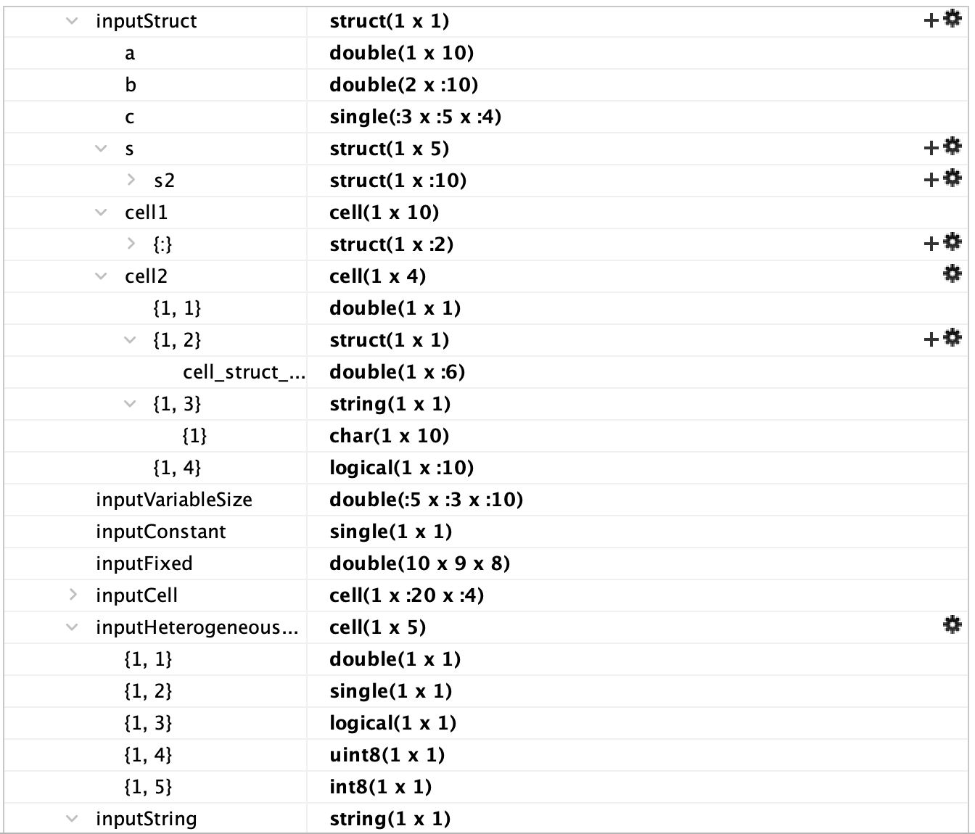
Test Case 2: this can be dangerous
I wanted to stress the capabilities of the input and output parser as much as possible. For this, I prepared this dummy function with the following input signature:
Here we found a limitation: Simulink does NOT support cell arrays as signals (we do...), so we cannot generate Simulink blocks. However, the output shows that the argument tree is succesfully reconstructed and the in-app test shows that the computed size of the structure equals the structure size as given by gdb.

Slide 24
EXTENDING THE FRAMEWORK

Slide 25
Workflow – recall
C/C++ code generation
zWrap
C code generation
C code generation
Host
Input parsing (type, size, …)
Input raw memory mapping
C++ call template generation
Memory mapping generation
IP stack configuration (Core0)
Linker script generation
Makefile tuning and execution
MATLAB interface generation
Simulink block library generation
C code generation
Generated C/C++ sources and headers
Drop-in MATLAB function
Drop-in Simulink Block Library
Codegen support files (buildInfo, codeInfo)
Board
C code generation
Vendor-specific
C code generation
SHARED MEMORY
(OCM, DDR)
0
1
BOOT.bin SD Card Image
Host Communication
lwIP Ethernet Stack
MATLAB Function
Board Support Package (BSP)

Slide 26
A broader vision
With the proper board support packages and toolchains, we could extend the framework in order to allow:
Different boards or boards setup
Different communication stacks
Different on-board application implementations
Full dual-core implementation with interrupts
Synthetization of Ethernet IP stack on the FPGA and full dual-core on the PS

Slide 27
What about the PL?
I started this project with a (rather foolish) idea in mind: to prepare a toolchain to deploy any application on an FPGA. However, I see a possible future extension of this work by selecting specific sub-routines to implement on the Programmable Logic (FPGA) with High-Level Synthesis.
PS
PL (FPGA)
Core0
Core1
function
subfunction1
HLS
subfunction2
subfunction3
HLS
subfunction4

Slide 28
LIMITATIONS

Slide 29
Limitation 1 – Dynamic Memory
Dynamic memory is currently (maybe) unsupported.
For sure, I didn‘t implement the emxArray implementation of MATLAB unbounded arrays. Under the current paradigm, it is not possible because unbounded arrays have non-definite size and therefore the input memory representation itself would be of undetermined size.
Dynamic memory is unsuggested on embedded targets in any case. For applications that use dynamic memory allocation internally, the board-specific implementation of malloc is available. In that case, it is suggested to increase the heap size with the –heap flag.
malloc

Slide 30
Limitation 2 – Cell Arrays in Simulink
As said, Simulink does not support cell arrays. Therefore, when defining the Bus objects starting from the MATLAB structures, the in-built Simulink.Bus.fromObject() returns an error because it does not know how to handle cell arrays.
SOLUTION: Convert cell arrays to structures with the cell{m,n} ←→ struct.fmn notation. Then, handle cells as simple structures.
{}

Slide 31
Limitation 3 – Specific Libraries
There is a set of libraries that have no version for selected boards. An example is the openMP (Open Multi Processing) library that requires the omp.h header – that simply does not exist for ARM boards.
The compiler would complain for this.
«««SOLUTION»»»: Remove the OpenMP library when generating code settings
-lomp, -lwhoknows, -lstrange

Slide 32
Limitation 4 – Custom MATLAB Classes (?)
To be fair, I marked this as a limitation just because I did not test any implementation of a custom MATLAB Class. However, there is currently a class named coderClass that inherits from coderNestedObject and should be able to properly parse the object with the corresponding memory representation.
?
obj = myClass();

Slide 33
Limitation 5 – Output type/size wrongly inferred by Simulink
Simulink is not able to correctly infer the output data size. This causes an error while propagating data sizes. Currently, the algorithm automatically fixes the output data sizes; however, this approach should be tested with variable-sized arrays.
Also, buses objects are currently initialized in the library according to the respective MATLAB structure. Tests should be performed to check wether pre-existing buses are compatible with the newly-defined.
?
[1, :2]

Slide 34
CONCLUSIONS

Slide 35

Conclusions
A tool to automatize the deployment of code-ready MATLAB functions has been developed, featuring:
Host-side memory serialization
Direct memory parsing and bare-metal execution on board (real-time compliant)
Lightweight IP stack for communication
Drop-in MATLAB function and Simulink block
Extendable code structure
The preliminary results are promising, but the toolchain should be tested with different applications in order to:
Identify bugs in the C/C++ sources or the generated MATLAB/Simulink functions
Identify additional limitations
Find the proper flags to use during the code generation

Slide 36
THANKS FOR YOUR ATTENTION

